Slide 1
Results Not Typical
Earn Higher Profits Than the World’s Greatest Investors

Slide 2
Amber Lee Mason
Stansberry Conference Series
Nashville
October 18, 2014

Slide 3
BIG Promises!
A Low-Risk Way to Make 50%-100% on America's Energy Revolution
The Best Way to Quickly Double or Triple Your Money
Risk $1 to Make $10 in This "Bad to Less Bad" Trade

Slide 4
“These Results Not Typical”

Slide 5
My Big Promise
You can realistically expect to make as much money as some of the greatest investors of all time.
You’re never going to see stocks the same way again.
This idea can make you more money with less risk than any other idea you hear about today.

Slide 6
How to Write a Newsletter
Picture: Tell a story.
Promise: Make it BIG!
Proof: Back up your claims.
Payoff: Here’s what to do about it.

Slide 7
The Picture

Slide 8
Average Annual Returns (1993-2012)

Slide 9
Average Annual Returns (various)

Slide 10
The Proof

Slide 11
A Single-Number “Screen” for the World’s Best Investments…
Untouchable by accountants
Easy to understand
Easy to look up
It tells you if…
The company has a sustainable competitive advantage
The business generates cash
The management team is focused on shareholders
The stock is likely to outperform in a correction

Slide 12
Dan Ferris: King of the WDDGs
Once I realized how silly it was to try to predict the stock market's direction, I started looking for a flow of investment returns I could count on.
No one has the option of stock prices that always go up. That doesn't exist. But everyone has the option of dividends that always go up. That does exist, and that's why investors who want to make consistent returns from stocks need to focus on dividends... and relentless dividend growers like WDDGs.
When the dividend goes up, the value of your investment goes up.

Slide 13
Tom Dyson: “High Performance” Stocks
According to Ned Davis, this small subset of "high performance" companies outperformed the overall market every year between 1972 and 2008.
"High performance" stocks returned 8.6% gains per year.
So what are these "high performance" stocks?
I'm talking about stocks that relentlessly raise their dividends. Stocks that raise their dividends are far and away the best performers in the stock market, year after year.

Slide 14
Porter Stansberry: Capital Efficiency
Most public companies – even the ones with great products and profits – only return a fraction of their profits back to their owners. Instead, the capital is destroyed through absurd investments, mergers, and criminal amounts of executive compensation.
I measure capital efficiency by looking to see how much of the company's gross profits end up being paid out to shareholders in the form of dividends or share buybacks.
The importance of capital efficiency is not well-understood by most investors, but it is absolutely critical. Businesses that don't require much capital will, as they get bigger, return higher and higher percentages of their gross profits to shareholders.

Slide 15
Dividend Aristocrats
Increased dividends 25 years in a row…
Stay in business…
Maintain a competitive advantage…
Pay your owners…
Survive and thrive despite recessions, market downturns, and bad management.

Slide 16
54 Current Aristocrats
3M Co
Abbott Labs
AbbVie
Aflac
Air Products & Chemicals
Archer-Daniels-Midland
AT&T
Automatic Data Processing
Becton Dickinson
Bemis
Brown-Forman
Cardinal Health
Chevron
Chubb
Cincinnati Financial
Cintas
Clorox
Coca-Cola
Colgate-Palmolive
Consolidated Edison
CR Bard
Dover
Ecolab
Emerson Electric
Exxon Mobil
Family Dollar Stores
Franklin Resources
Genuine Parts
HCP
Hormel Foods
Illinois Tool Works
Johnson & Johnson
Kimberly-Clark
Leggett & Platt
Lowe's
McCormick
McDonald's
McGraw Hill
Medtronic
Nucor
Pentair
PepsiCo
PPG Industries
Procter & Gamble
Sherwin-Williams
Sigma-Aldrich
Stanley Black & Decker
Sysco
T Rowe Price Group
Target
VF
Wal-Mart
Walgreen
WW Grainger

Slide 17
Performance to Date

Slide 18
Average Annual Returns (1993-2012)

Slide 19
Dividend & Share Price Growth (1990-2013)

Slide 20
Doc Eifrig: Compounding
Simply stated, compound returns are money you make off the money you make.
So if you invest $1,000 for a 10% return, you make $100 and end up with $1,100. If you invest $1,100 of money for a 10% return, you make $110 and end up with $1,210. That extra $10 was money you made on the money you made.
It starts small like that. But over time, your wealth grows like kudzu when you compound your money.

Slide 21
Over 20 Years…

Slide 22
Over 30 Years…

Slide 23
Over 50 Years…

Slide 24
Average Annual Returns (various)

Slide 25
Objections
It takes too much time.
That’s ALL it takes.

Slide 26
Objections
You’ll miss out on a lot of great stocks.
Great companies
Aristocrats

Slide 27
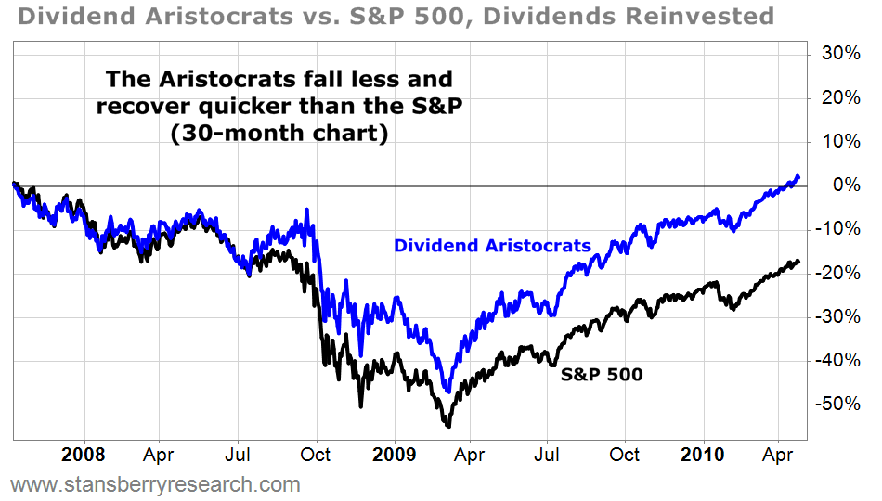
Objections
These stocks are too expensive.

Slide 28
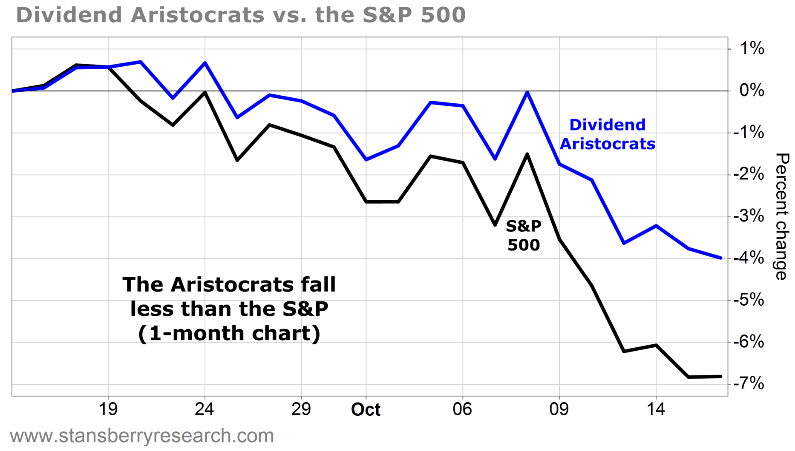
Objections
These stocks are too expensive.

Slide 29
The Payoff

Slide 30
Action to Take
Buy the ProShares Dividend Aristocrats Fund (NOBL)
Holds all 54 stocks in the Dividends Aristocrats Index
Low 0.35% expense ratio
Launched a year ago… tracks the index spot-on
Tell your broker to reinvest your dividends. It’s free!

Slide 31
More Actions to Take
Download this presentation, at stansberryresearch.com/amber-lee-mason. You can also check out a free trial for DWT there.
Email me at dwt@stansberryresearch.com.
For basic trading education, go to www.YouTube.com and search Amber Lee Mason.
Look for more on the work I’ll be doing with Bill Bonner and the publishing company Bonner & Partners.
Thanks for watching and good trading!

Slide 32
Results Not Typical
Stansberry Conference Series, Nashville, October 18, 2014

